Slide 1
FYP5: Object Detection, Tracking and Suspicious Activity Recognition for Maritime Surveillance using Thermal Vision

Slide 2
Research Into Activity Detection
Off-line Activity Detection
Most of the work has been published in this domain
Not suitable for our project which requires real-time activity detection
Online Spatio-Temporal Activity Detection
Fewer work on this domain
Online Temporal only Activity Detection
More focus on temporal only activity detection in real-time detection
Online Spatio-Temporal Activity Detection + Real-time Object detection
Similar to Mask RCNN having both instance segmentation and object detection
Thermal Activity Detection
No Deep Learning based approaches have been published
Unique algorithm specialized for thermal images that runs faster and achieves the accuracy of either the state-of-the art of surpass it
Can approach in two ways:
Annotating an existing thermal dataset that contains several activity classes (ex: FLIR Thermal Dataset)
Create our own publishable thermal dataset

Slide 3
Existing Techniques
2D-Object Detector base
Tubelet linking - Singh et al. (2017 ICCV) (Online), He et al. (2018 WACV), Kalogeiton et al. (2017 ICCV)
Recurrent Tubelet Generation - Li et al. (2018 ECCV), Zhao et al. (2019 CVPR)
Hierarchical Self-attention head – Pramono et al. (2019 ICCV)
Conv-LSTM - Song et al. (2019 CVPR)
3D-ConvNet Base
Xu et al. (202 arXiv)
Transformer Network head - Girdhar et al. (2019 CVPR)
2D and 3D combined approach
Sun et al. (2018 ECCV)
Progressive Learning - Yang et al. (CVPR 2019)
VideoCapsuleNet
Duarte et al. (2018 NIPS)

Slide 4
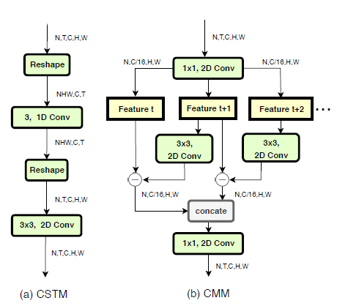
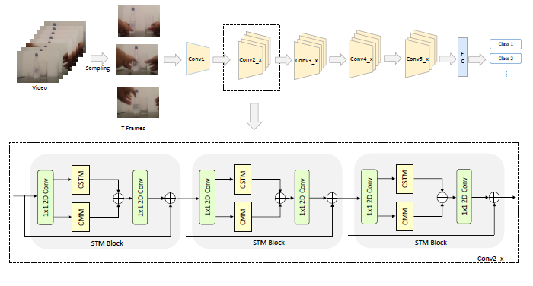
Design Ideas - Primary
Develop a temporally aware 2D base network
Jiang et al. (2019 ICCV) – Action Recognition
Memoryless
“Motion Module”
Replaces a convolutional block in 2D CNN
Requires all frames to work
Li et al. (2016 arXiv) – VideoLSTM – Temporal
Action Detection
Has memory
Considers spatial relationships
Long term dependencies also captured
Purpose: Replace optical flow stream

Slide 5
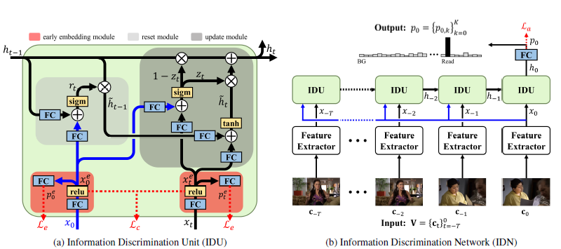
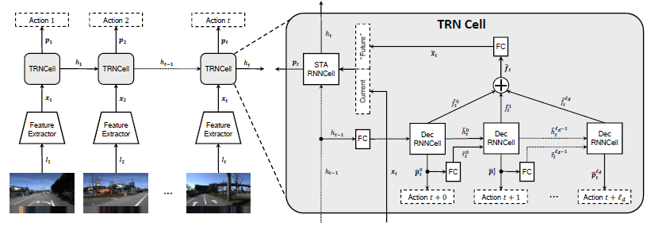
Design Ideas - Primary
Develop temporally aware network head
Xu et al. (2019 ICCV) – Temporal Recurrent Network
Eun et al. (2020 CVPR) – Information Discrimination Unit
Both based on Temporal only
Purpose – Development of a new feature-aware tube generation algorithm
Need a Tube-localized prediction

Slide 6

Tasks for next week
Modifying Activity detection pipeline with Cornernet-Lite

